Slide 1
Flooring
Safety in flooring.
1. Conduct a floor and walkways audit.
2. Wipe and organize work areas.
3. Repair problem areas.
4. Create floor cleaning and maintenance procedures
5. Establish foot-wear guidelines.
6. Implement slip, trip and fall prevention control.
7. Use containment and absorbents in areas wit regular leaks and drips.
8. Prepare for spills.
9. Use appropriate signage, barricades and lightning.
10.Learn about floor safety.

Slide 2
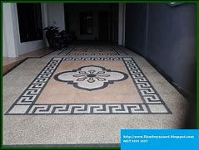
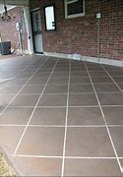
Basic flooring finishing.
1.Carpets
-Advantages : 1. It is inexpensive. 2. It is soft.
-Disadvantages : 1. It holds dust. 2. It is difficult to clean.
2. Ceramic tiles
-Advantages : 1. Durable 2. Easier to clean.
-Disadvantages : 1. Cold surfaces. 2. Uncomfortable.

Slide 3
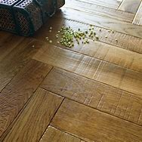
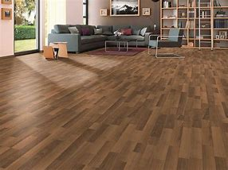
3.Solid wood floors
-Advantages : 1. Easy maintenance. 2.Long term investment.
-Disadvantages : 1. It is expensive 2. Scratching.
4.Laminate floors
-Advantages : 1.Resistant to stains. 2. Resistant to fading.
-Disadvantages : 1. Prone to water damage. 2. warping if installed improperly.

Slide 4

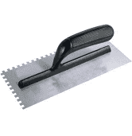
Basic flooring tools.
1.Stanley knives
- It is used for fastening and loosing screws.
2.Trowels
- It is used for general hammering.

Slide 5

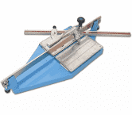
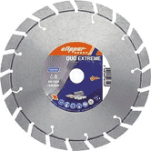
3.Spacers
- It is used for fastening and loosing screws.
4.Tile cutters
- It is used for general hammering.
5. Cutting edges
-It is used for general hammering.

Slide 6
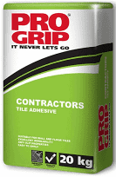

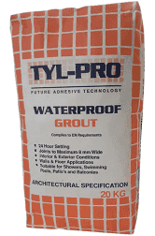
Basic flooring materials
1.Tile cements
- It is used for fastening and loosening of bolts, nuts and fittings.
2.Glue
- It is used as a cutting tool..
3.Grouts
- Demonstration

Slide 7
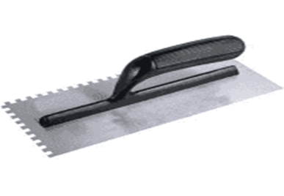
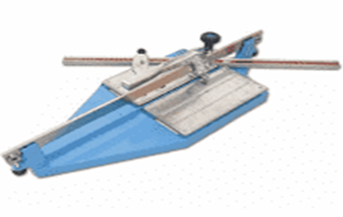
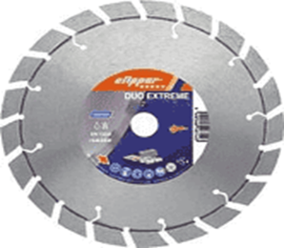

Kwa Thema Skills School
Subject : Maintenance Marks : 12
Grade : Year 2 Time : 30mins
Date :
Question:1
1.Name the following flooring tools.
1.1.__________________ 1.2.______________________
1.3.___________________ 1.4. ______________________

Slide 8
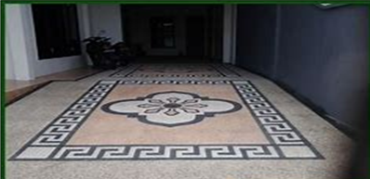

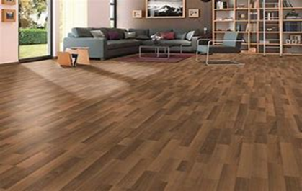
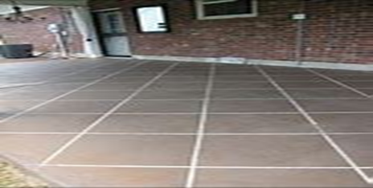
2. Name one advantage and disadvantage of the following flooring finishing shown below:
Carpet Solid wood floor
Advantage Advantage
1. ________________________________ 1. _____________________________________
Disadvantage Disadvantage
1. ________________________________ 1. ______________________________________
Laminate floor Ceramic tiles
Advantage Advantage
1. ________________________________ 1. _____________________________________
Disadvantage Disadvantage
1. ________________________________ 1. _____________________________________
(14)

